Slide 1
Bullying
BELTON MIDDLE SCHOOL
“WARRIORS”

Slide 2
Warrior Anti-Bullying Goals
EDUCATE 6th-8th graders about bullying
ADDRESS bullying
PREVENT bullying

Slide 3
What is bullying?
Bullying is aggressive behavior that is intentional and that involves an imbalance of power or strength (Olweus, 1993; Roland, 1989; Smith & Sharp, 1994).
Notes:
¼ students are bullied
1/5 students admit to being a bully
160,000 students miss school each day for fear of being bullied
Bullying and cyberbullying contribute to youth violence and drug/alcohol abuse
43% of students fear harassment in bathrooms and locker rooms

Slide 4
Forms of Bullying
Physical
Verbal
Emotional
Cyberbullying
Sexual
Racial

Slide 5
Forms of Bullying
Physical – Harmful actions against another person’s body.
Examples:
Biting | Kicking
Pushing | Pinching
Hitting | Tripping
Pulling Hair

Slide 6
Forms of Bullying
Verbal – Speaking to or about a person in an unkind or hurtful way/tone.
Sarcasm | Teasing
Name-Calling | Putting-Down
Phone Calls | Hurtful Gossip
Spreading Rumors

Slide 7
Forms of Bullying
Emotional– Upsetting, excluding or embarrassing a person.
Intentional Exclusion | Nasty Notes
Tormenting | Threatening
Humiliation | Social Embarrassment
CYBERBULLYING

Slide 8
Forms of Bullying
Sexual– Singles out a person because of gender and/or sexual orientation and demonstrates unwarranted/unwelcome sexual behavior.
Sexual Comments
Abusive Comments
Unwanted Physical Contact

Slide 9
Forms of Bullying
Racial- Involves rejection or isolation of a person because of ethnicity.
Gestures | Racial Slurs
Taunts | Name-Calling
Making fun of: customs, skin color, accent and/or food choices.

Slide 10
Who Is Involved In Bullying?
Bully:
One or more persons who intentionally intimidate or harm another person.
A bully has power or social support. The harm they cause can be physical, emotional or both.

Slide 11
Who Is Involved In Bullying?
Victim:
The person who is being bullied.
The victim has less power or social support and often blames him/herself for the abuse.

Slide 12
Who Is Involved In Bullying?
Bystander:
One or more people who stand on the sidelines and passively witness acts of bullying – bystanders might also actively provide encouragement to the bully.
Bystanders may not seek help/intervene because they fear for their safety, may lose friends, become a target or be labeled a tattletale or snitch.

Slide 13
Why Does Bullying Occur?
Bullying can be related to hostile acts perpetrated against racial and ethnic minorities, gay, lesbian, and bi-sexual youth, and persons with disabilities.
This definition is taken from the American Psychological Association.

Slide 14
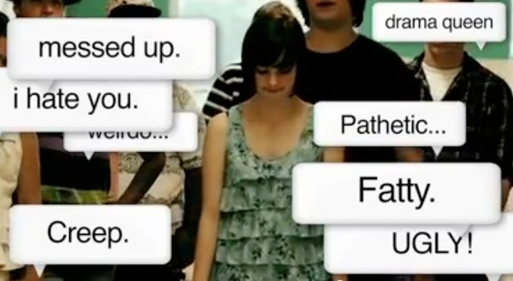
Cyberbullying
Cyberbullying Definition:
“The willful and repeated harm influenced through the use of computers, cell phones, and other electronic devices.”

Slide 15
Cyberbullying vs. Bullying

Slide 16
Cyberbullying Examples
Sending mean texts, e-mails, or instant messages
Posting offensive pictures or messages about others in blogs or on Web sites
Using someone else’s user name to spread rumors or lies about someone
Sending repeated notes
Forwarding supposedly private messages, pictures or videos to others
Threatening or harassing others with offensive language
Cyberbullying is more difficult too detect and victimization is ongoing!

Slide 17
When bullying occurs…
“STOP” the action
“WALK” away
&
“TALK” to someone who can affect change

Slide 18
Resources
Olewus, D. (1993). Bullying at school: what we know and what we can do. NY: Blackwell.
Roland, E. (1989). A system oriented strategy against bullying. In E. Roland & E. Munthe (Eds.), Bullying: An international perspective. London: David Fulton Publishers.
Smith, P.K., & Sharp, S. (1994). School bullying: Insights and perspectives. London: Routledge.

